Slide 1
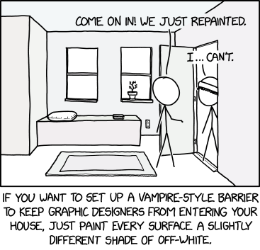
User interface design
xkcd

Slide 2
UI Design: Friday Sept 30
Dr. Jillian Aurisano
Plan for today:
Announcements/Course logistics
Color
Activity
Notes:
So welcome to engineering visual interfaces for data science. I'm Dr Aurisano.
Thanks for finding the class on Zoom. Hopefully we will be in person again soon.
If anyone out there is comfortable turning on their cameras, that is lovely- then I feel like I am talking to students, rather than to myself.
Here’s our plan for today:
First I’m going to introduce myself, so you know a bit about me
Then we are going to get to know each other, in Zoom breakout rooms. This will give us a chance to make sure that Zoom breakout rooms work, and we all know how to access them.
Then, I am going to walk through the structure, and plan for the course. I want to make sure everyone knows how the course will work, and what to expect, and also a bit about why the course is designed this way.
Then I am going to introduce the class, and what the class is about. Since this is a new class, and one of just a few classes in human centered computing here at UC, I wanted to give an overview of the topic.
Then I have an introductory activity, which we will do in breakout rooms, and which I think will help motivate the discussion on Wednesday, and getting into the meat of the class.

Slide 3
Code jam
Not much interest in doing a code jam today (based on the recent google form)
Next week: 4:30-6:30pm better?

Slide 4
Let’s talk about color!!

Slide 5
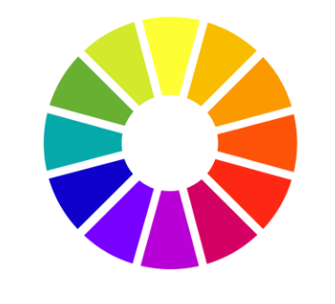
How can we think about color?
Color wheel
Let’s look at 3 dimensions of color:
Hue
Saturation
Value

Slide 6
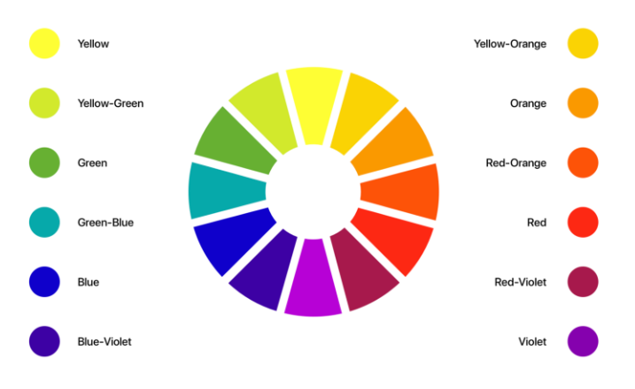
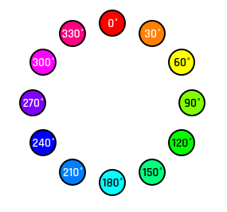
Hue
Probably the first thing we think of
What color is it? Blue
Can be defined on a scale from 0 to 360
https://uxdesign.cc/all-you-need-to-know-about-colors-in-ui-design-theory-practice-235179712522

Slide 7
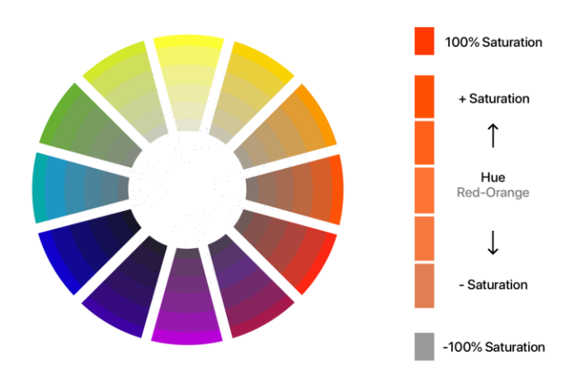
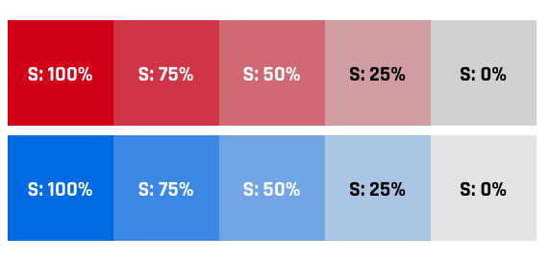
Saturation
Intensity of the color
Richness of the color
100% saturation: bright color
0% saturation:
dull color
Range from white, grey to black, depending on the value
Defined on a scale 0 to 100
https://uxdesign.cc/all-you-need-to-know-about-colors-in-ui-design-theory-practice-235179712522

Slide 8
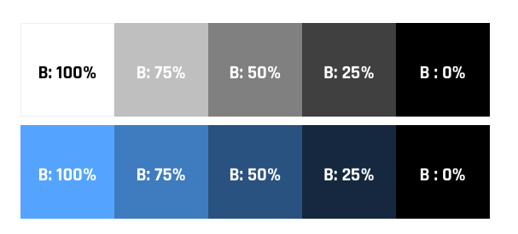
Value
Value is the amount of light and darkness color has
How bright the color is
Value 100%: bright color
Value 0%: black
In between: light->dark shades of a hue
https://uxdesign.cc/all-you-need-to-know-about-colors-in-ui-design-theory-practice-235179712522

Slide 9
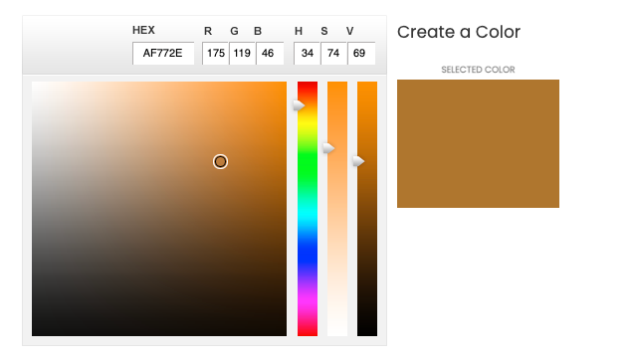
Let’s play with this….
COLOURlover.com
There are other great sites out there too….

Slide 10
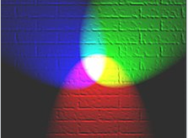
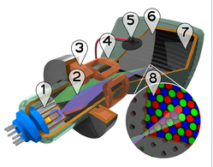
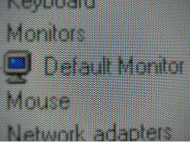
Alternate color model: RGB (Red, Green, Blue)
RGB
Red value (0-255, or 0.0-1.0)
Green value (0-255, or 0.0-1.0)
Blue value (0-255, or 0.0-1.0)
Light , how displays work
RGB is additive
Light spectra add together to produce the color
Displays use RGB in how they present color to users
Closely positioned red, green and blue light sources - > pixel color at that spot

Slide 11
Let’s play with this….
COLOURlover.com

Slide 12

There is also a hexidecial representation of the RGB colors
Don’t have to type as many numbers…

Slide 13
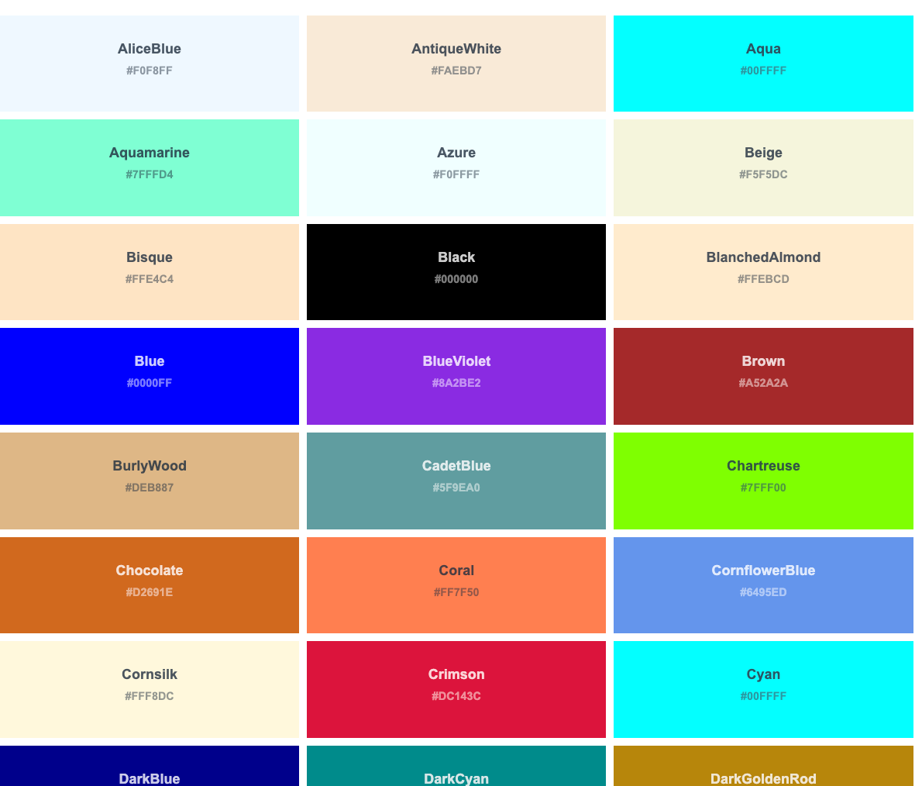
Or can use color names
https://www.w3schools.com/tags/ref_colornames.asp

Slide 14
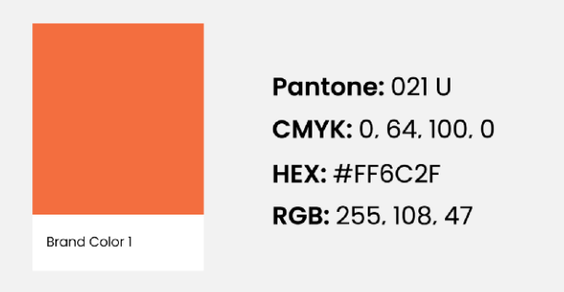
Color creation

Slide 15
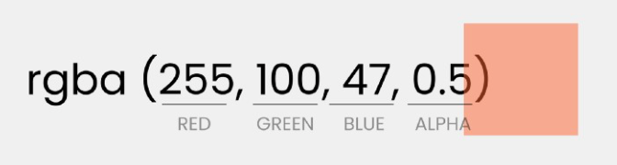
Alpha: transparency
RGBA

Slide 16
Color websites
https://htmlcolorcodes.com/
https://material.io/design/color/the-color-system.html#tools-for-picking-colors
https://www.colourlovers.com/palettes/add
https://coolors.co/
http://paletton.com/#uid=1000u0kllllaFw0g0qFqFg0w0aF

Slide 17
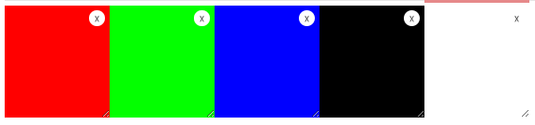
A few basics
In general, DON’T use straight Red 100%, Blue 0%, Green 0% colors

Slide 18
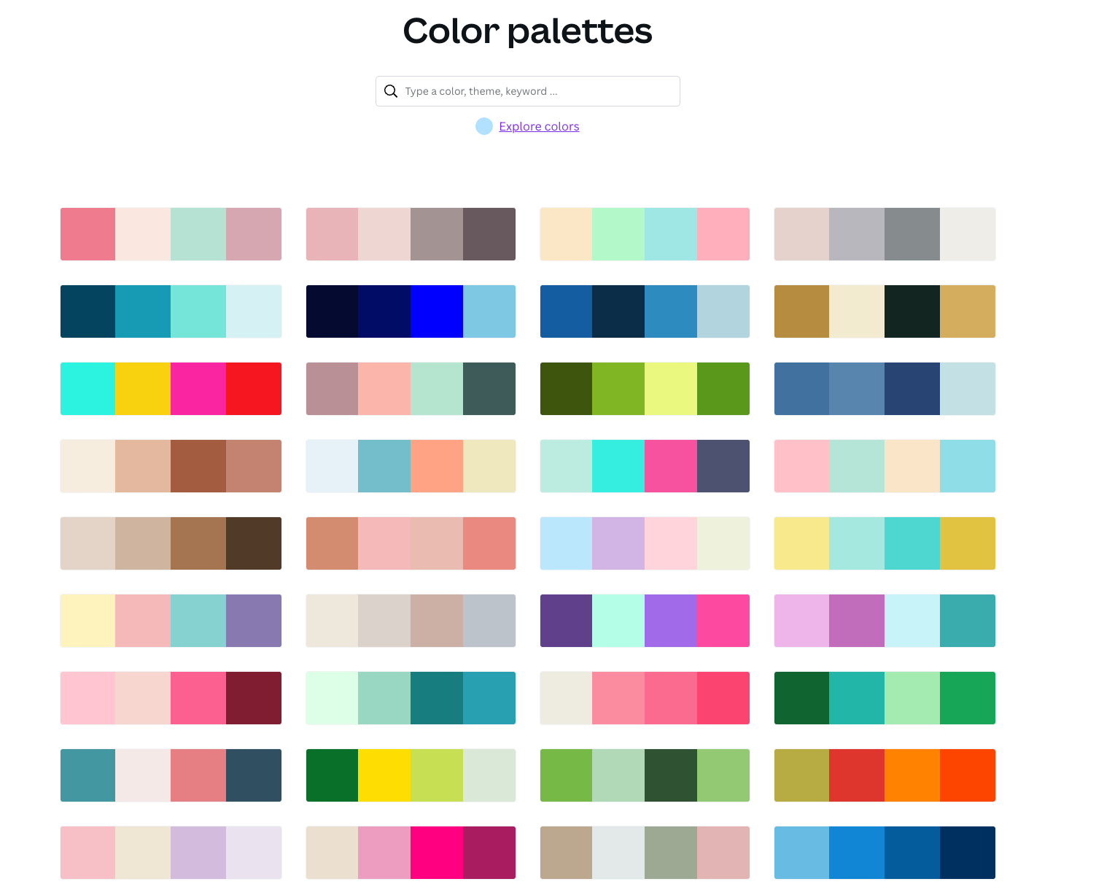
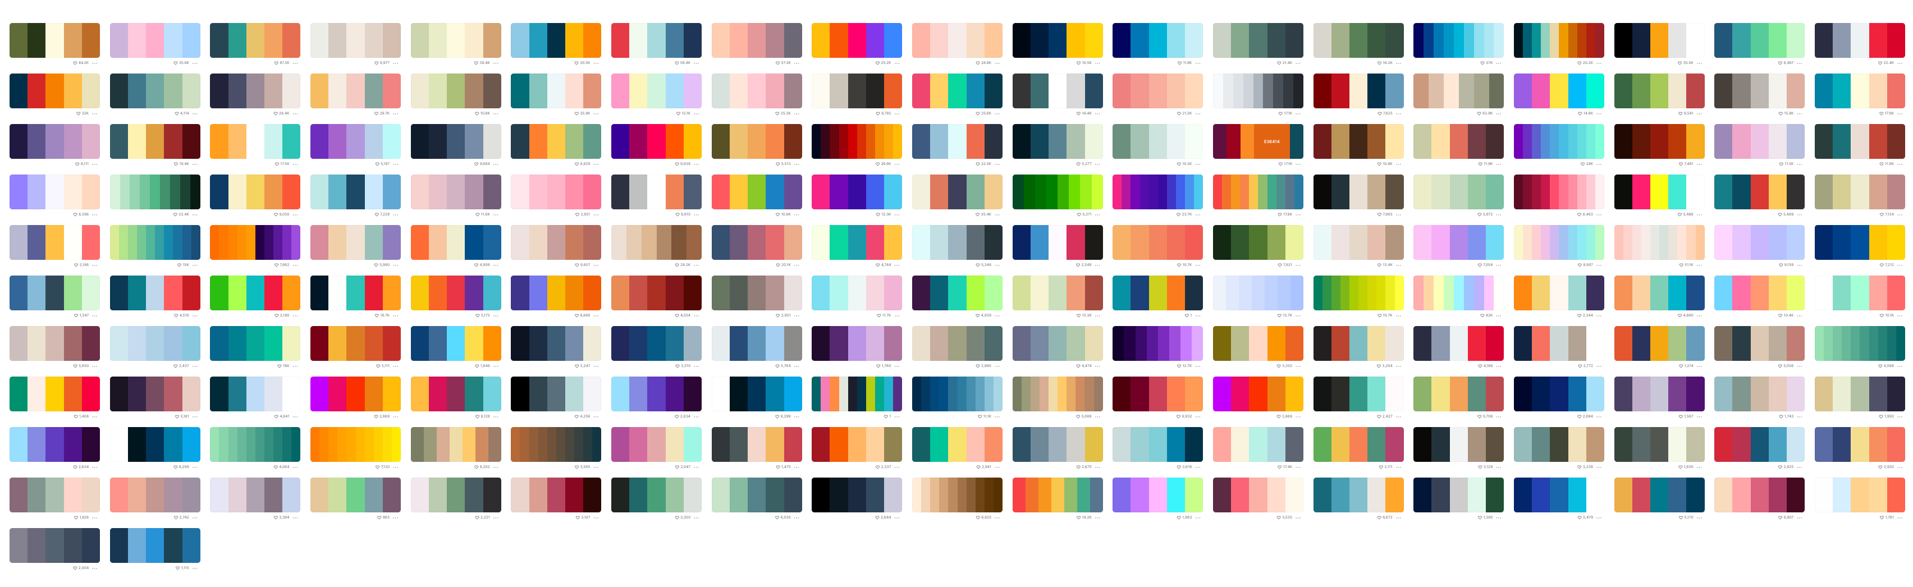
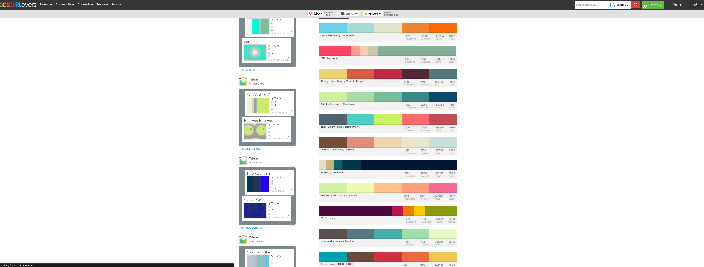
If you are unsure: use resources
Canva.com
Coolors.co
ColourLover.com
List here:
https://htmlburger.com/blog/ui-color-scheme/

Slide 19
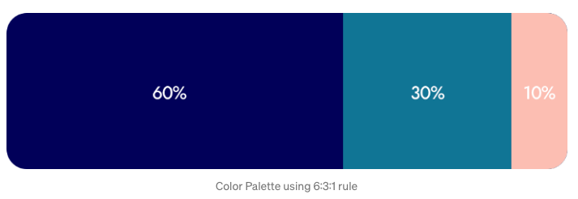
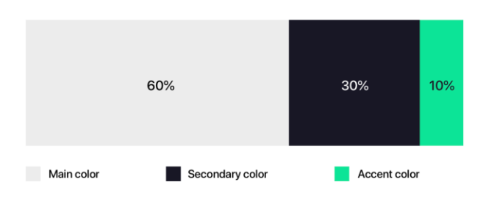
Rule of 60 – 30 – 10
“Golden ratio”
Main color: 60%
Secondary color: 30%
Accent color: 10%
Can help you avoid having too many colors

Slide 20
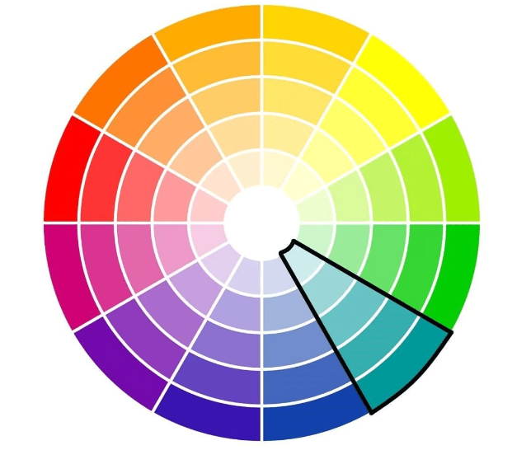
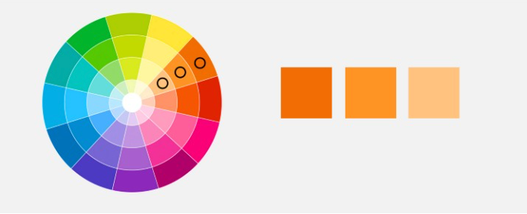
Monochromatic color schemes
Pick a color, choose variations on that color (modify saturation or value)
”sophisticated”
”subtle”
https://www.oberlo.com/blog/color-combinations-cheat-sheet
https://uxplanet.org/ultimate-guide-to-color-in-ux-ui-design-de8eb104b5d3

Slide 21
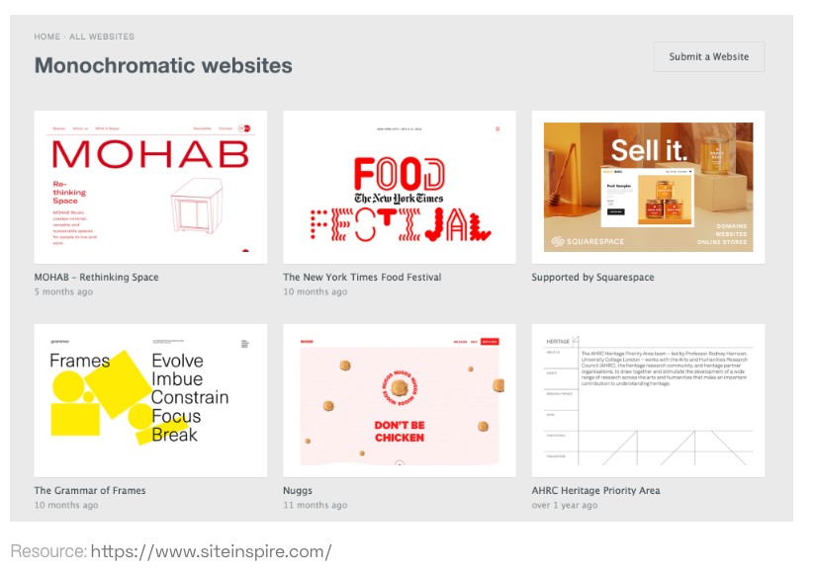
Monochromatic

Slide 22
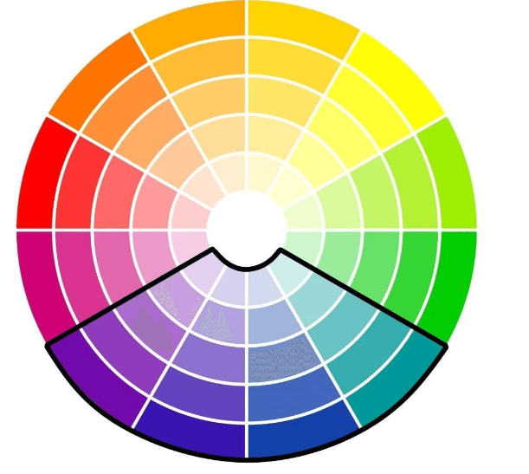
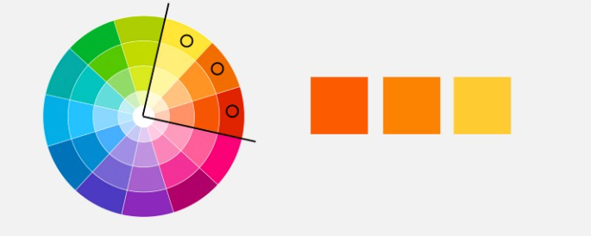
Analogous color schemes
Hues next to each other on color wheel
”dynamic”
https://www.oberlo.com/blog/color-combinations-cheat-sheet
https://uxplanet.org/ultimate-guide-to-color-in-ux-ui-design-de8eb104b5d3

Slide 23
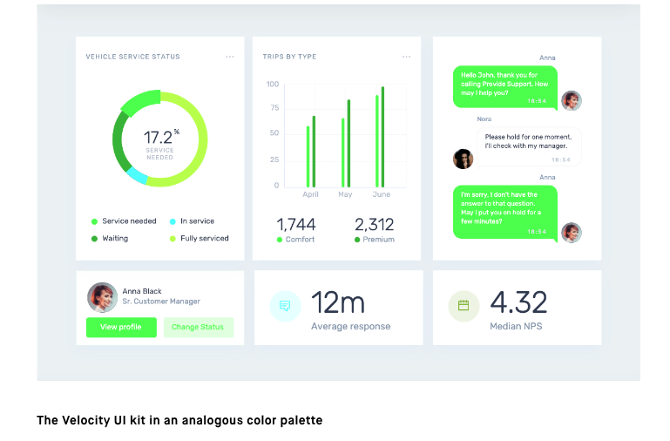
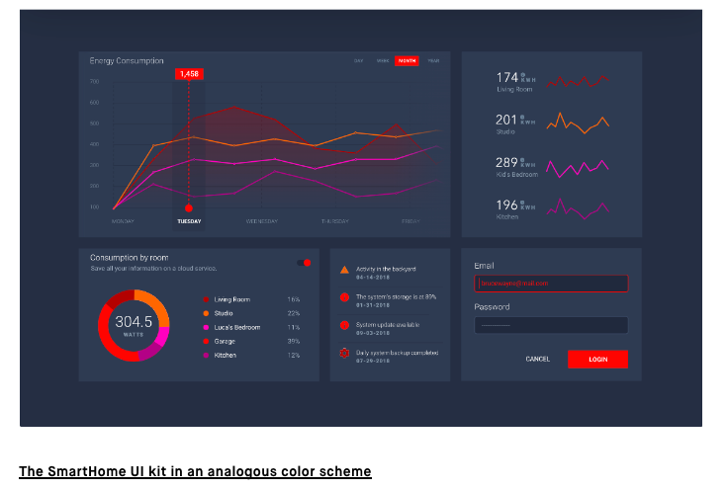
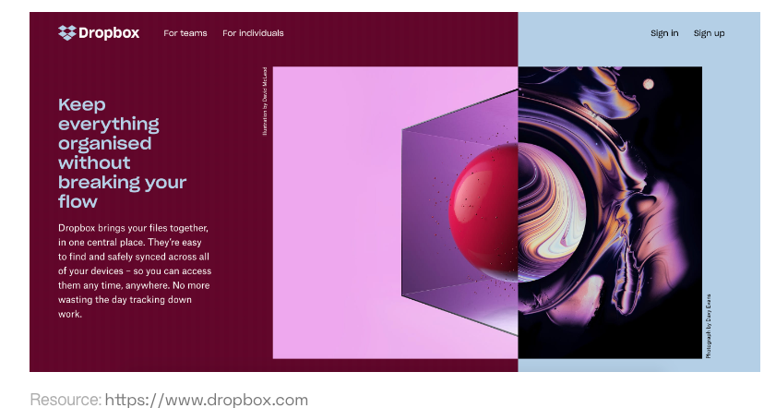
Analogous color schemes
https://www.invisionapp.com/inside-design/analogous-colors/

Slide 24
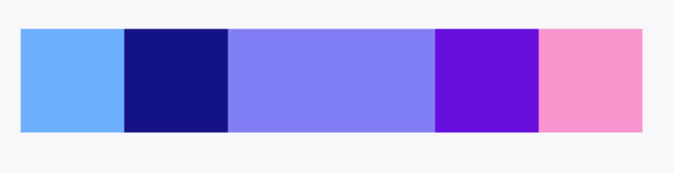
Analogous color schemes
Add variety with shifts in saturation and brightness

Slide 25
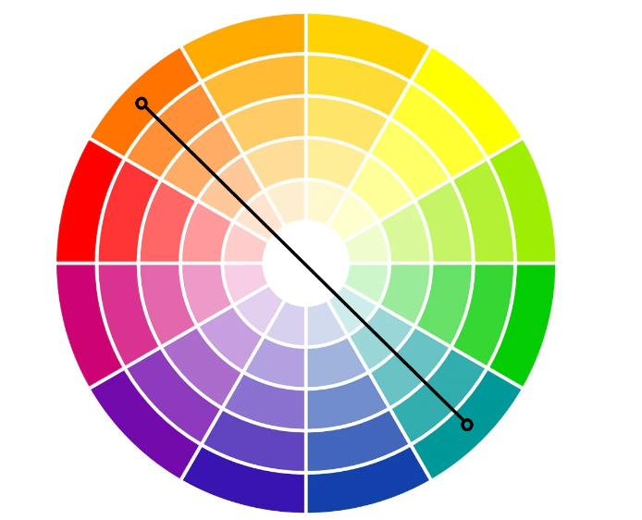
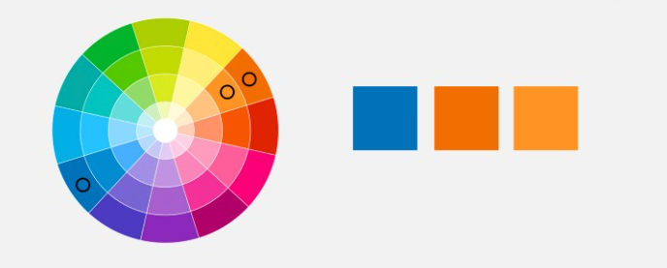
Complementary
Across the color wheel:
Base color: blue
Complementary color: orange
Optional Add a monochromatic color: light orange
“Vibrant”
Interplay of cool and warm colors
https://www.oberlo.com/blog/color-combinations-cheat-sheet
https://uxplanet.org/ultimate-guide-to-color-in-ux-ui-design-de8eb104b5d3

Slide 26

Complementary

Slide 27
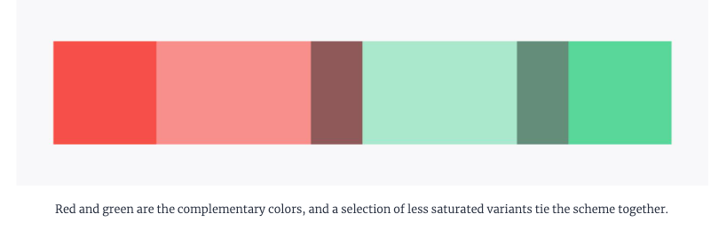
Complementary
Adding variation in saturation and value

Slide 28

But be careful….
Complementary colors of the exact same saturation and value
“pulsing effect”
Can be uncomfortable

Slide 29
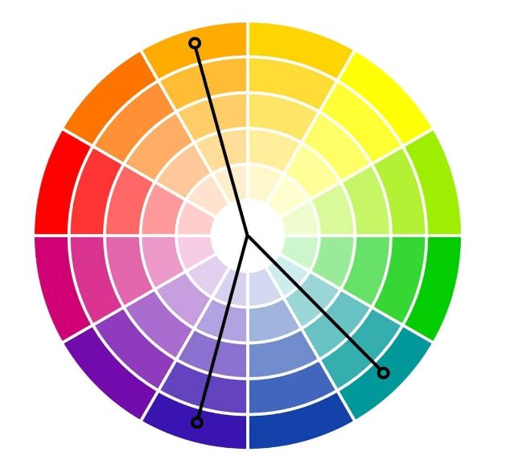
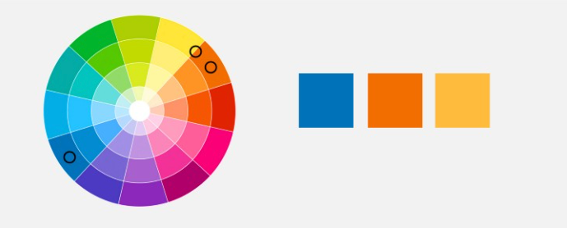
Split complementary
Across the color wheel
Base color: blue
Choose 2 colors across the color wheel, slightly split/offset
https://www.oberlo.com/blog/color-combinations-cheat-sheet
https://uxplanet.org/ultimate-guide-to-color-in-ux-ui-design-de8eb104b5d3

Slide 30
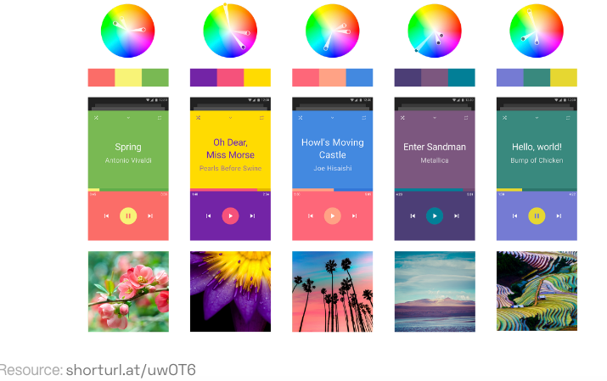
Split complementary

Slide 31
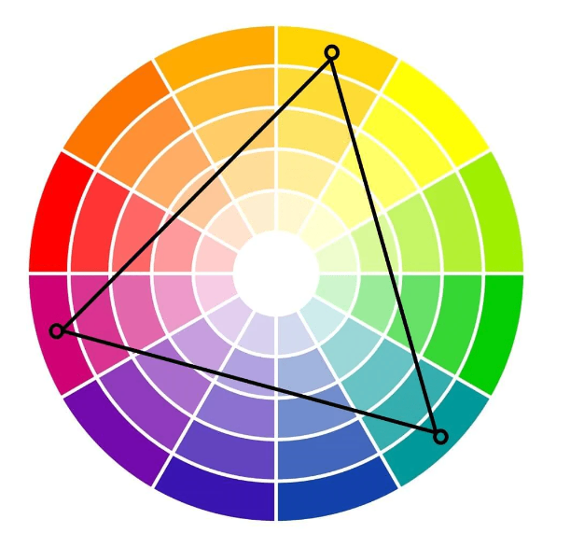
Triadic
Choose colors in triangle configuration
Red, Yellow, Blue
Purple, green, orange
Playful, youthful
Could be overwhelming
https://www.oberlo.com/blog/color-combinations-cheat-sheet

Slide 32
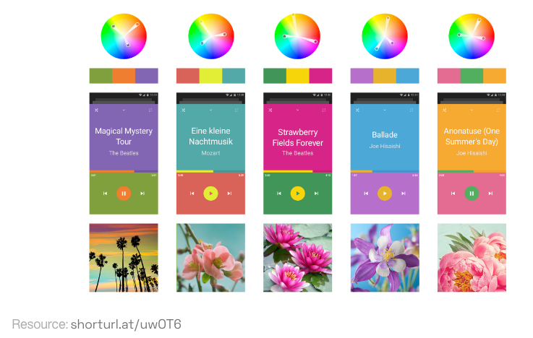
Triadic

Slide 33
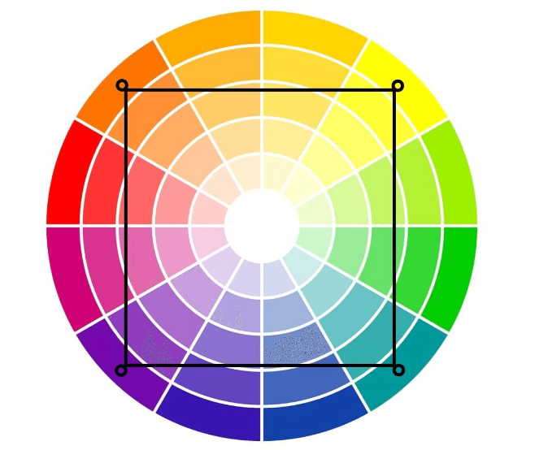
Tetradic color schemes
Colors are equidistant
Pick 4
Loud, fun, vibrant
But potentially overwhelming
https://www.oberlo.com/blog/color-combinations-cheat-sheet

Slide 34
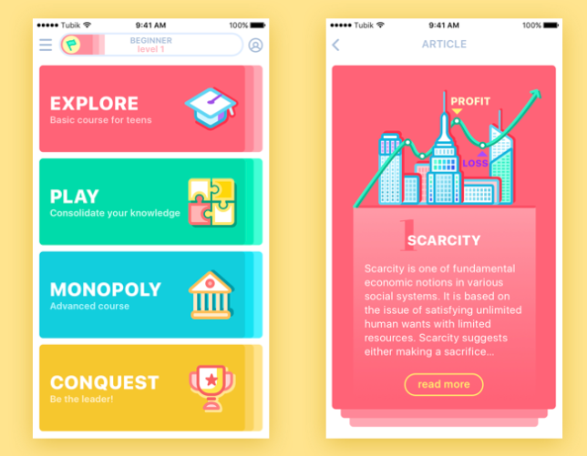
Tetradic
https://www.qed42.com/insights/coe/design/understanding-colors-ui-design

Slide 35

Blue
Blue
Cool color
Trust, credibility
Most common favorite color

Slide 36
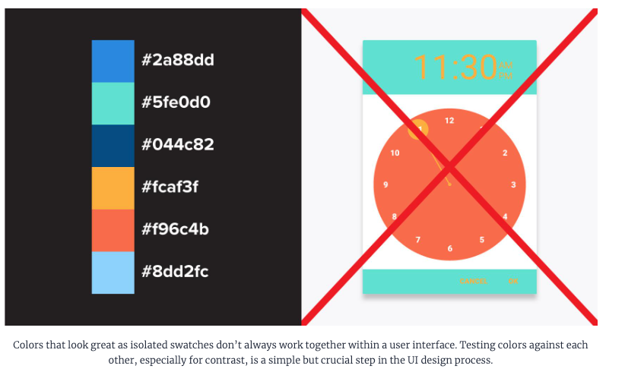
Note:
https://www.toptal.com/designers/ui/ui-color-guide

Slide 37
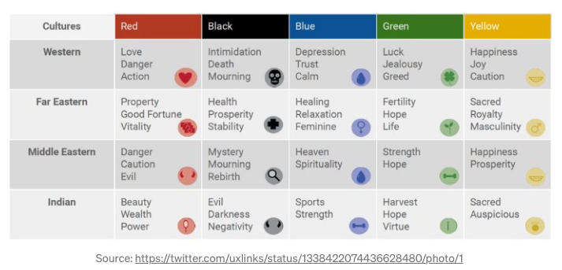
Colors associations are cultural Color associations change over time
Lots of the rules we find out there are tailored to European/American audiences

Slide 38
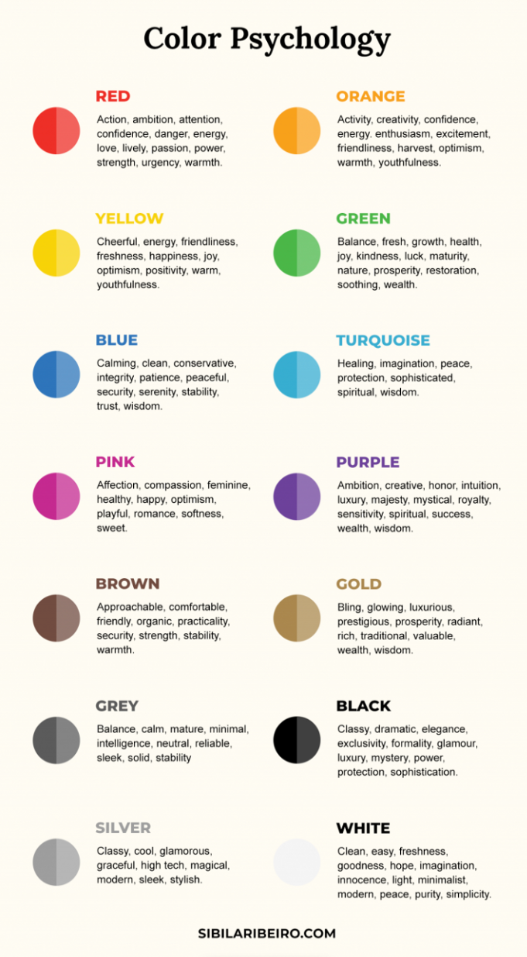
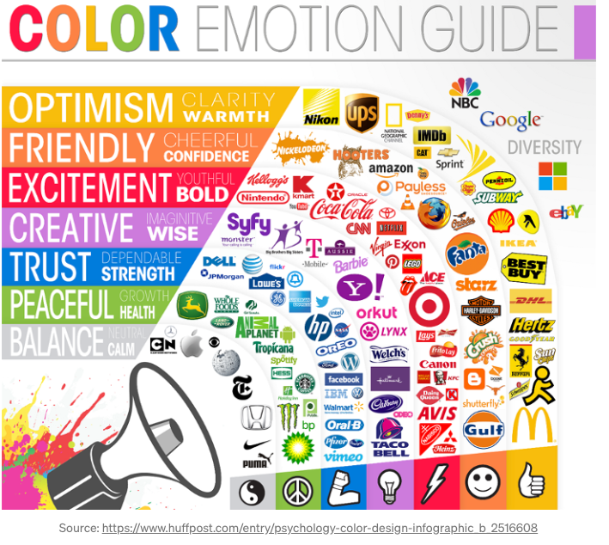
Some color psychology….

Slide 39
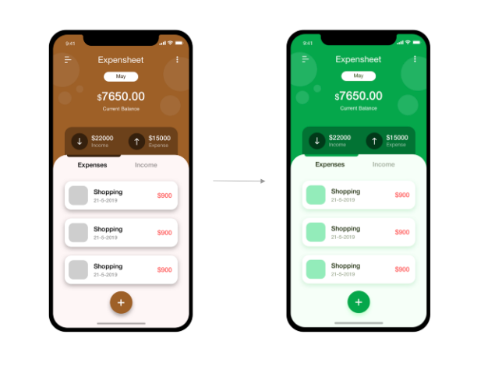
Color matters
https://medium.com/iconscout/colors-in-ui-design-theory-psychology-practice-f6d6a5e6e04d

Slide 40
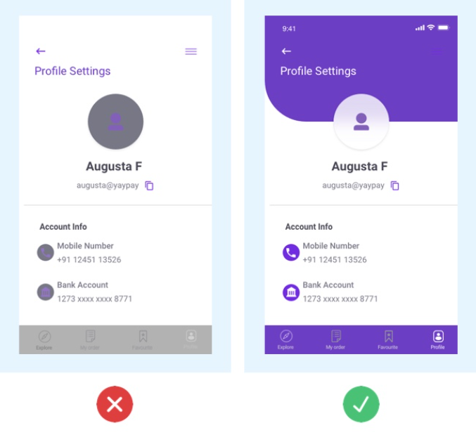
Contrast
Contrast in a UI is used to draw attention
If you have low contrast between visual elements, they may all blur together
How to use contrast:
Draw attention: high contrast for calls for action
Separate sections: use contrast to partition elements
Background/foreground: use contrast to bring elements to the foreground

Slide 41
Contrast is also important for accessibility
Viewing in varied lighting conditions
People with vision impairments
People with color blindness

Slide 42
Color blindness
Color blindness is more common than you may think (10% of men and 1% of women)
There are several forms of color blindness
Most common: Red, green color blindness
Let’s see how we all do…
(sometimes someone discovers they are color blind in class =O )
Do you see these numbers?

Slide 43
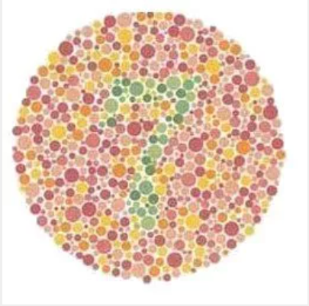

Slide 44
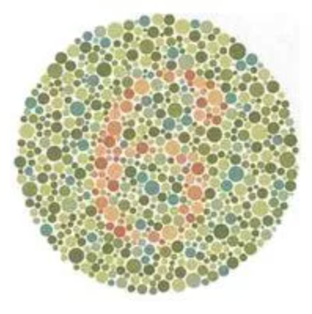

Slide 45
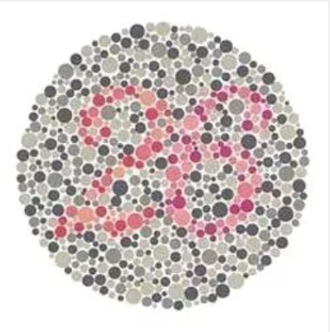

Slide 46
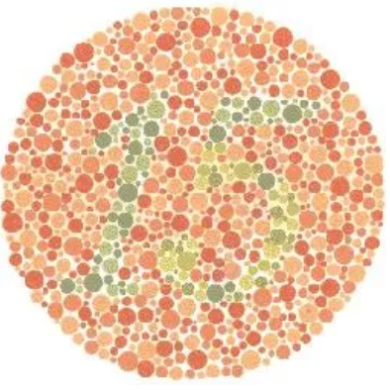

Slide 47
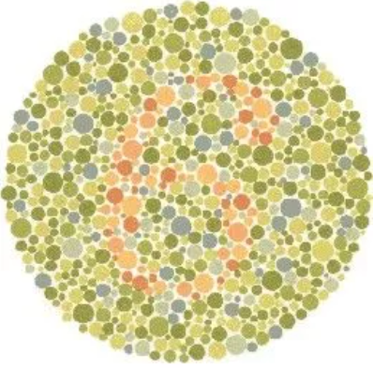

Slide 48


Slide 49


Slide 50


Slide 51


Slide 52


Slide 53


Slide 54


Slide 55

Check for color blindness

Slide 56

Color blindness and color wheel

Slide 57

Color blindness and UI
If you only use color to indicate if something is selected, depending on the color, a color blind user may not be able to tell it is selected
https://www.toptal.com/designers/ui/ui-color-guide

Slide 58

Color blindness and UI
Use text, icons with color
Don’t rely on color alone

Slide 59

Checking accessibility
WebAIM
noCoffee
Accessibility scanner

Slide 60
Let’s explore color

